Slide 1
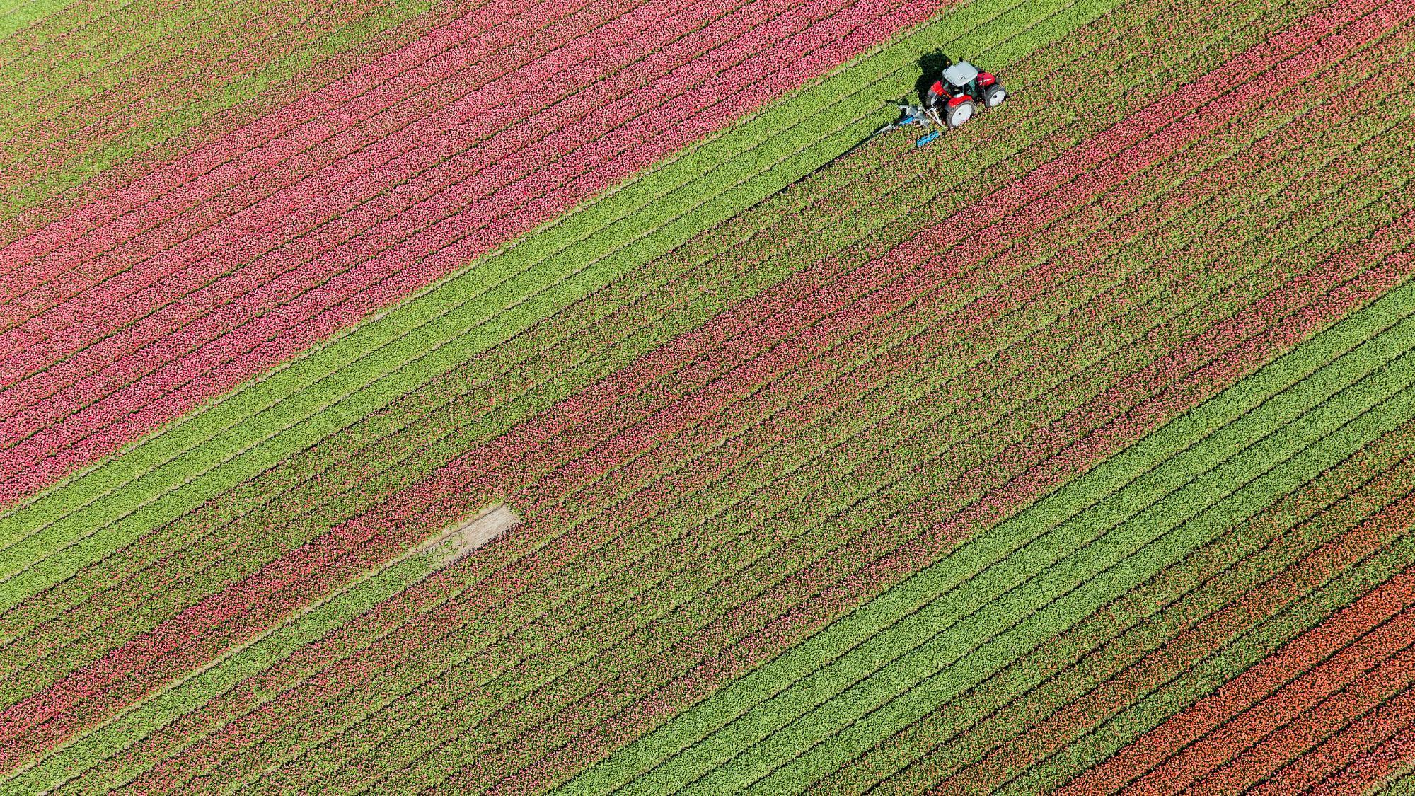
Weather and Crop Yield
Stamatios Karvounis
x18197051@student.ncirl.ie

Slide 2


Agenda
Introduction
Related work
Methodology
Results
Future

Slide 3



Introduction
Analyse the impact of temperature and precipitation fluctuations on crop production volume in California over the last 20 years.
California considered the largest food producer in the USA and plays a crucial role in meeting the food demands of the world's population, producing wide range of crops, unique climate that is well-suited for agriculture
Correlations between average, minimum and maximum temperatures, and the quantities of major crops
The objective of this proposed study is to provide a quantitative analysis of the relationship between climate and crop production over a specific period.
Research question: How do temperature fluctuations affect the yield of major crops in California?

Slide 4

Related Work (Lobell, Cahill, & Field, 2007)
Previous study examined how weather affects agricultural production in California by analyzing the relationship between crop yields and monthly temperature and precipitation for 12 major crops.
The impact of climate on crop yield trends varies depending on the crop.
California's diverse agriculture reduces the effects of climate change on the agricultural sector
1980-2003 is outdated and may not fully reflect current irrigation practices and climate changes.
The 2014 drought in California impact on crop yield, consideration of other factors like irrigation systems.

Slide 5
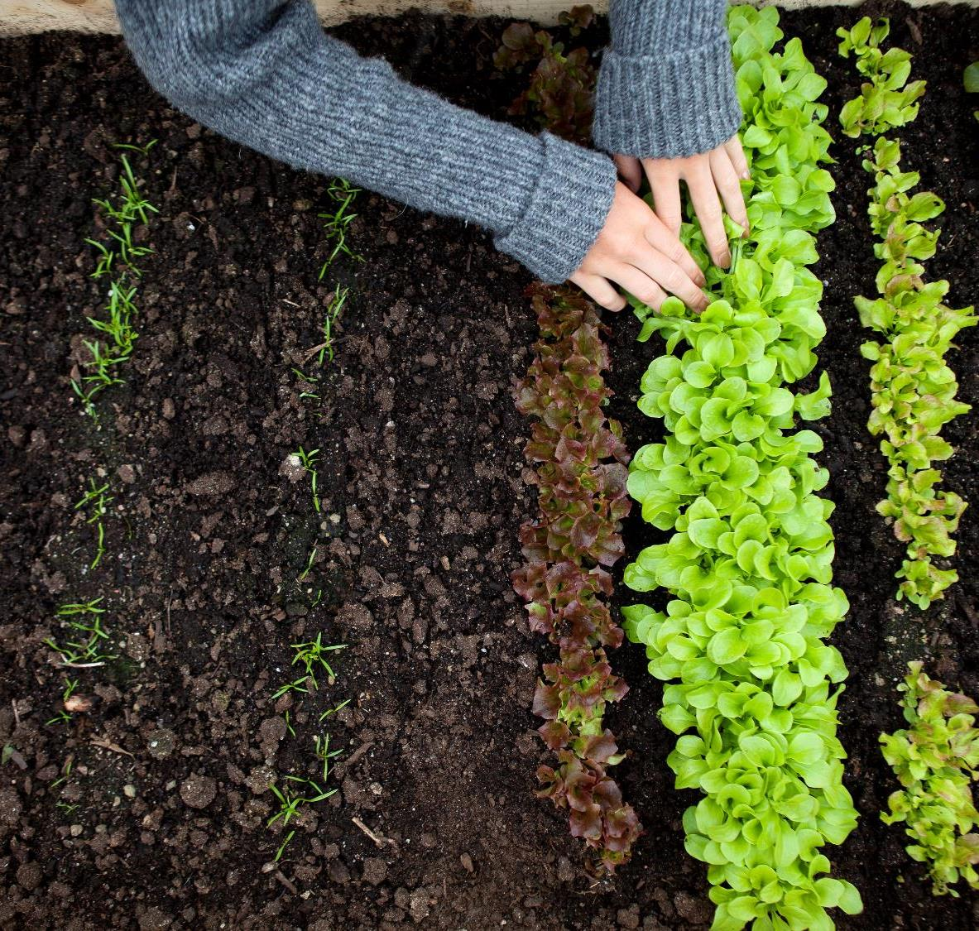
Methodology

Slide 6





3 Steps
National Centers for Environmental Information | Food and Agriculture Organization of the United Nations | Merged Dataset
API (JSON semi-structured dataset) from https://www.noaa.gov/. | Csv file exported from https://www.fao.org/faostat/en/#data/QCL | Merge of the 2 datasets after storing and conducting ETL process
Stored in MongoDB database | Stored in PostgreSQL database | Stored in local drive as csv
ETL using MongoDB Compass | ETL using PG Admin 4 | Used Jupyter notebook in Anaconda environment for Visualisation and Analysis
This Photo by Unknown Author is licensed under CC BY-SA
This Photo by Unknown Author is licensed under CC BY-SA

Slide 7


Daily Summaries-MongoDB
A semi-structured dataset was obtained from the website noaa.gov using their API
The API endpoint URL was set to 'https://www.ncei.noaa.gov/cdo-web/api/v2/datasets’ adding the location parameter to California
Stored in a MongoDB database after setting up a connection and inserting the data using Jupyter notebook and terminal.
The MongoDB Compass for interaction with the database.
ETL process used a pipeline with four stages, including removing null values, excluding insignificant variables, converting string variables to their respective values, and adding a new variable.
6 variables: DATE, PRCP, TAVG, TMAX, TMIN, and temperatureDifference.
The ETL process used a pipeline with four stages, removing null values, excluding insignificant variables, converting string variables to their respective values, and adding a new variable.
Export to a CSV file and later imported into a postgreSQL

Slide 8
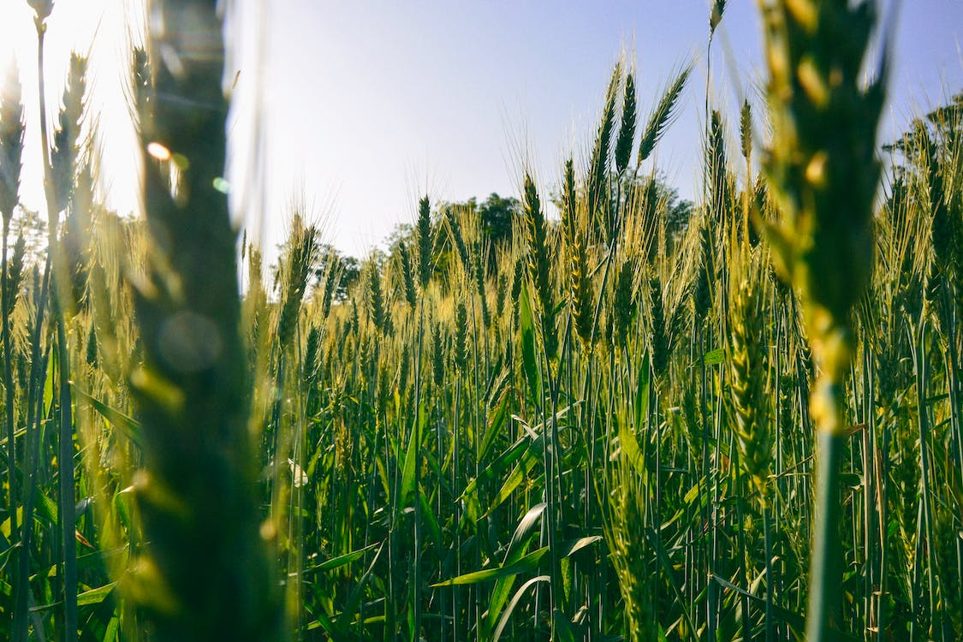

Crop Yield-PostgreSQL
Dataset exported from the FAOSTAT database, selecting from various variables according to my research objective
Variable categoriesselected: Countries (USA), Elements (yield), Items (crops and livestock), and Timeframe (2003-2022)
The dataset was saved in a csv file and imported into the Postgresql database
Postgresql and PG Admin 4 were used for efficient data management and ETL
Create server -> Create User -> Create Database -> Create schema -> Create table for crop production
-> Create table for daily summaries -> Copy data from the faostat csv file to the new table
ETL process: selecting distinct values, removing rows with NULL values, dropping insignificant columns, grouping data by year and item, exporting in CSV format
Resulting dataset: year_code, element_name, item_name, and total_value as variables

Slide 9

Merged Dataset
Anaconda Jupyter Notebook was used to perform the data analysis.
Pandas library was used to import the CSV files
The two datasets were merged using the merge function, year_code variable used as the common variable
Data visualization techniques were used to gain insights (Seaborn and Matplotlib).
The analysis helped identify trends and patterns related to crop yield and the impact of climate conditions on crop production over time.

Slide 10
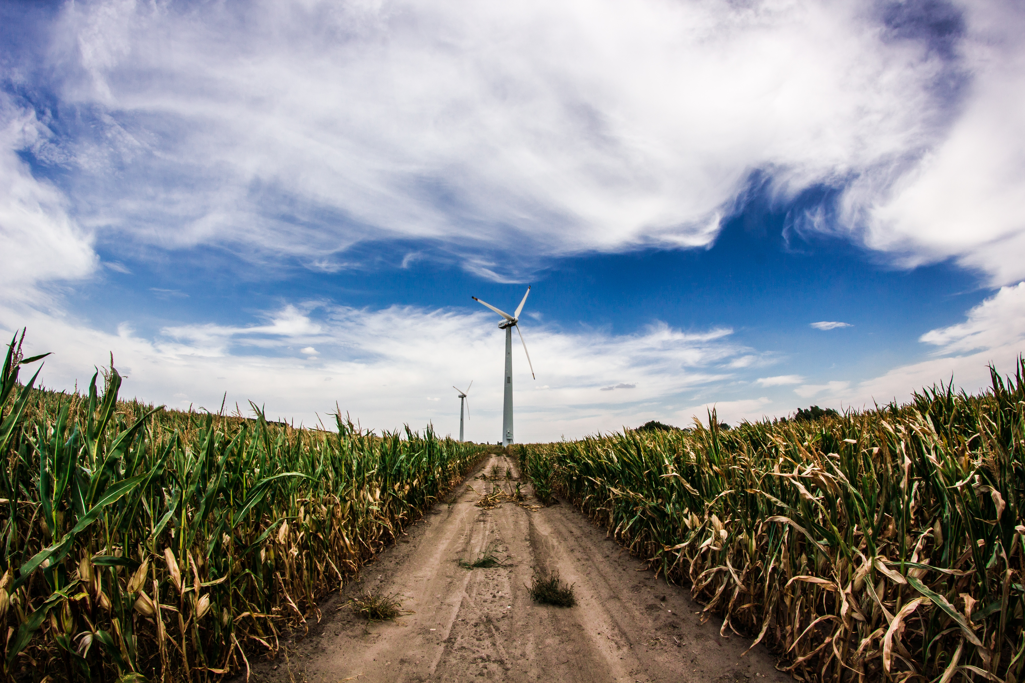
Visualizations and Results
Average precipitation was lower between 2012 and 2015, which aligns with reported drought in California during that timeframe.
Positive relationship between crop yield and minimum/maximum temperatures
Correlation matrix notied weak negative correlation between average precipitation and total value of production, and weak positive correlation between average temperature and crop yield total value.

Slide 11
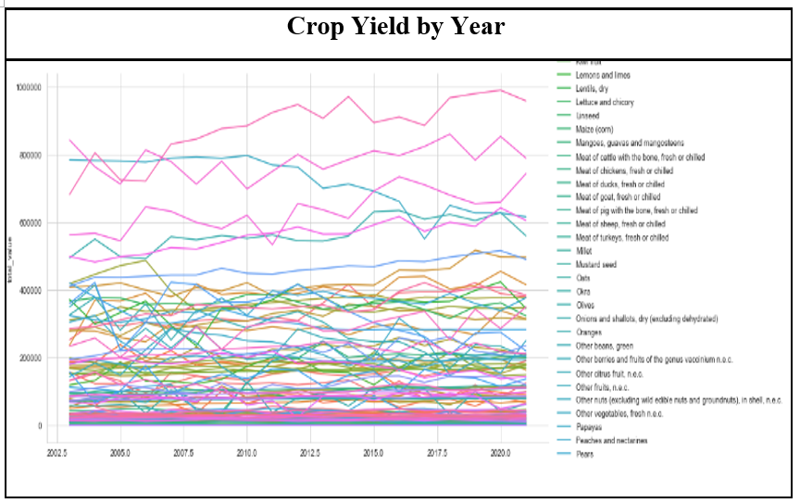
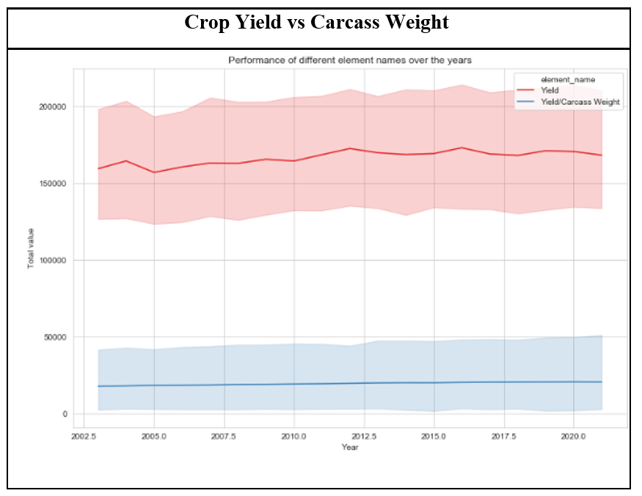
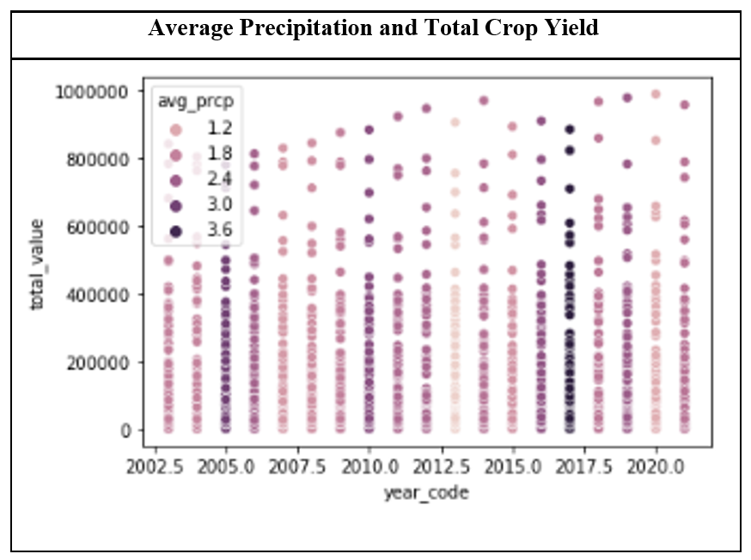
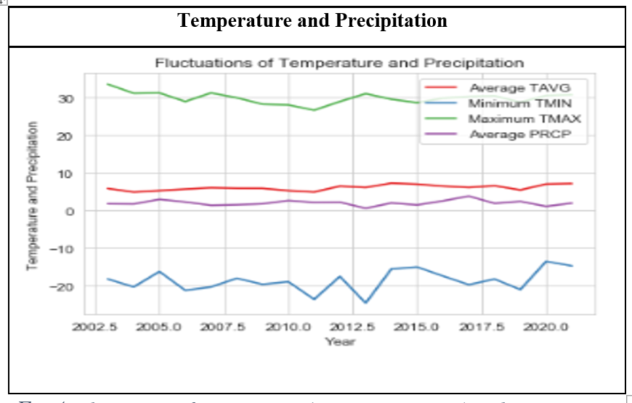
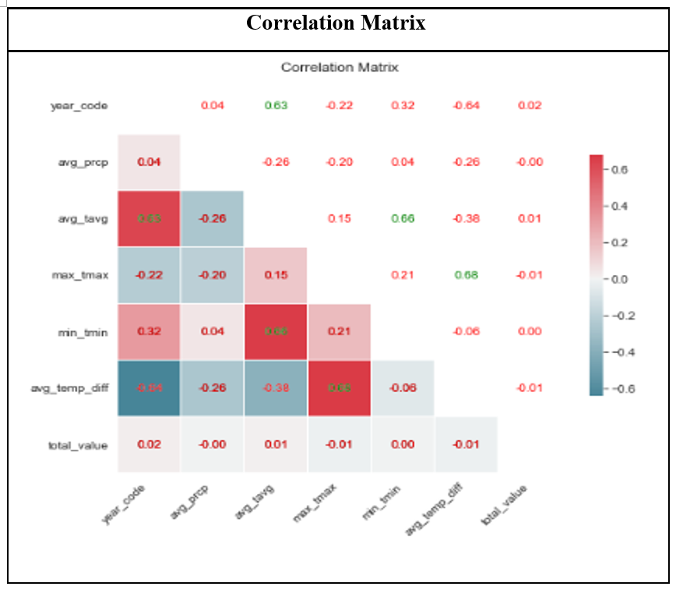
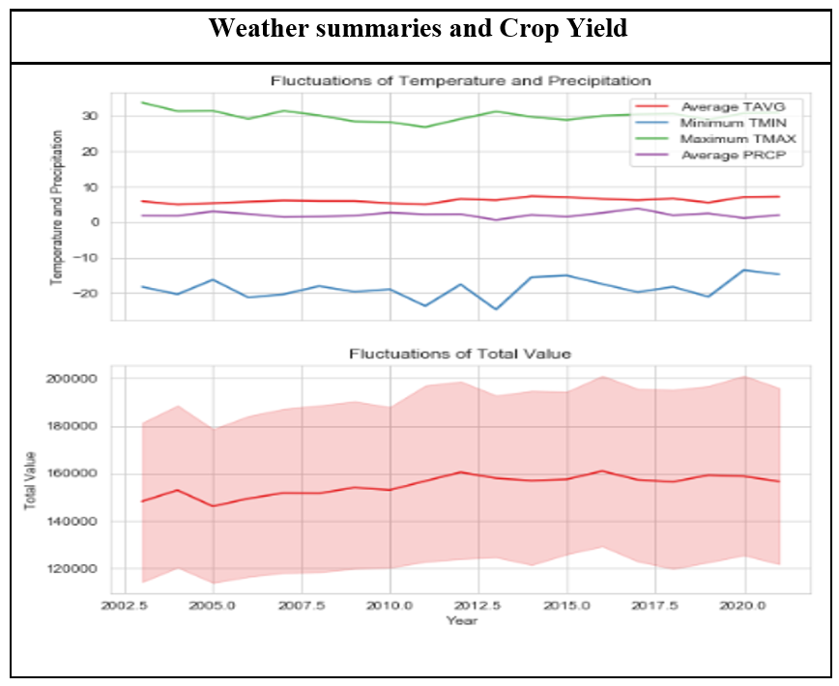

Visualizations

Slide 12

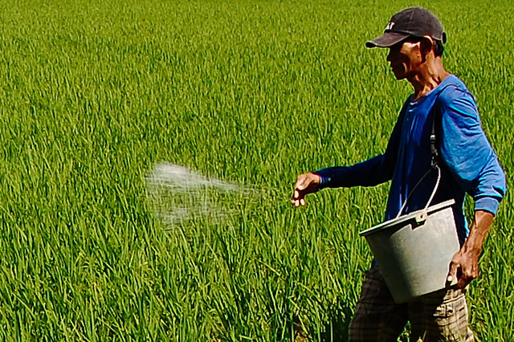
Future
Weak negative correlation between average precipitation and total crop value
Weak positive correlation between average temperature and total crop value, but the relationship is not linear due to fluctuations in minimum and maximum temperatures.
Further research is needed to fully understand the complexities of climate-crop production relationships.
The database can be easily extended to include additional variables
Weather conditions on different crops, studying how changes in temperature and precipitation affect crop prices, and analyzing data by season to better understand how weather affects crop growth and development.
This Photo by Unknown Author is licensed under CC BY-SA-NC

Slide 13




Thank You
All additional files are included in the submission folder
Python files with
MongoDB queries
PostgreSQL queries
Vizualisations
Project draft with rough descriptions of the stages
Stamatios Karvounis
x18197051@student.ncirl.ie

